Slide 1

Specification Demo
EKE 749 Group Assignment 2
Team 6, Code Monkeys.
Notes:
6조의 specification demo 발표를 맡은 이대홍입니다.
저희 조의 이름이 code monkeys이기 때문에 monkey그림을 올렸습니다.

Slide 2
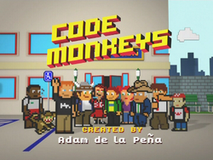

Code Monkeys
Notes:
First, I explain code monkeys.
Code Monkeys has two means.
First is an American animated television program in the early 1980s.
Second, A Code monkey is a computer programmer or other person who writes computer code for a living.
This term may be slightly derogatory, meaning that this developer can write some code but is unable to perform the more complex tasks of software architecture, analysis, and design^{[1}
But, we use this name paradoxically.

Slide 3
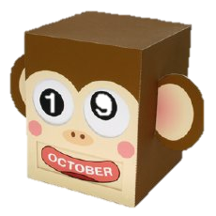
Introduce
Group name : Code Monkey
Project name : Monkey Calendar
Notes:
So, our group name is code monkey.
And our project name is also about monkey.
This monkey seems very cute. Isn’t it?
So, Our project name is Monkey Calendar.

Slide 4
Contents
Objective
Features
Environment
Notes:
오늘은 크게 objective와 features 그리고 environment의 순서로 발표하겠습니다.

Slide 5
Objective
Write a calendar and appointment scheduler system.
    Construct features, interface, limitation, etc..
    Add windowing (GUI) or browser interface, instead of just text
Notes:
이번 프로젝트의 objective는 write a calendar and appointment scheduler system.
This system is Constructed by features, interface, limitation, etc…
특히 인터페이스 부분을 강조하기 위해 우리 조는 windowing interface를 사용하였습니다.
이 얘기는 뒤에서 좀더 자세히 하도록 하겠습니다.

Slide 6
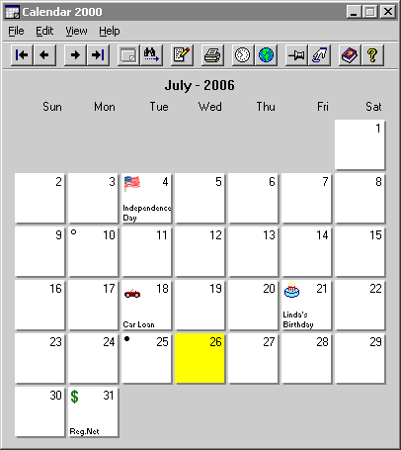
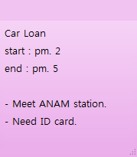
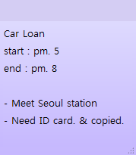
Print the calendar
Basic Requirements
Notes:
앞에서 설명한 것과 같이, 우리는 GUI, 즉 graphic user interface를 사용합니다.
따라서 우리는 picture를 이용하여 어떤 기능이 들어갈지 설명하겠습니다.
우선, 기본적인 기능들에 대해 설명하겠습니다.
이 그림은 단지 설명을 위해 사용하였습니다.
우리가 나중에 구성할 interface는 다를 수 있습니다.
이 그림에서 기본적으로 달력에서와 같이 year, month and day를 print하게 됩니다.
그리고 어떠한 일정이 생길 경우, 시간, 날짜, 등을 기록할 수 있습니다.
appointment를 change 하거나, clear 하는것도 가능합니다.

Slide 7
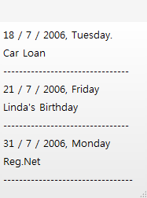

Save & Load
Basic Requirements
Load
Appointment1.MC
Save
Notes:
Next, If my appointments are like this, we can print all appointments for a given year, month, week, or day.
It’s good for seeing all appointments easily.
And we can Save & Load the set of all appointments to a file like this.

Slide 8

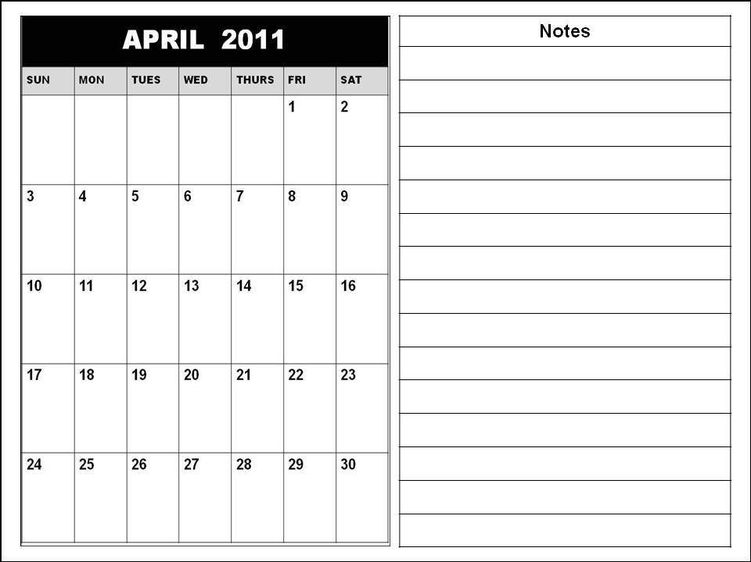
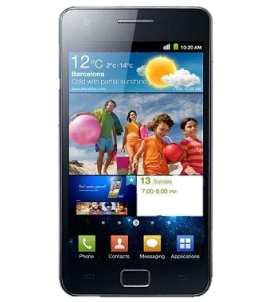
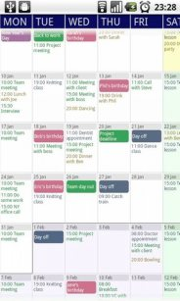
GUI interface
Additional fields
Notes:
처음에 말했던 것과 같이, monkey calendar는 gui interface를 사용합니다.
이를 위해, 우리는 android를 이용하여 monkey calendar를 구현할 예정입니다.
이와 같이 android를 이용하여 작업함으로써, smart phone을 이용하여 쉽게 사용이 가능할 것입니다.
참고로, 이 달력은 우리의 인터페이스가 아닌, googling을 통해 가져온 이미지입니다.

Slide 9
Add additional fields
Additional features
FEBRUARY
Name
Car Loan
Day
2 / 4 / 2011
Start
Pm. 5
End
Pm. 8
Location
Seoul station
People
Car manager
Need ID card & copied
Description
Notes:
여기서부터는 monkey calendar의 추가적인 기능에 대해 설명하겠습니다.
기존의 메모가 다음과 같다면
monkey calendar는 additional fields를 가지고 있습니다.
Location, people과 같은 정보를 따로 구별하여 적을 수 있습니다.

Slide 10
Repeating Appointments
Additional fields
FEBRUARY
Name
Volunteer Work
Day
2 / 9 / 2011
Start
MARCH
Pm. 2
End
Pm. 7
Location
Korea univ.
People
Colleague
Sometimes location will be changed.
Memo
Notes:
Next, monkey calendar can repeat appointments.
We can repeat appointments every weeks.
Or every month.
It is good for setting appointments like card payment, weekend business report.

Slide 11
Spanning appointment
Additional fields
FEBRUARY
Name
Team meeting
Day
2 / 4 / 2011
2 / 4 ~ 2 / 8
Start
Pm. 5
End
Pm. 8
Location
Room. 312
People
Description
Notes:
Monkey calendar is also good for not one day appointment but also multiple days appointment.
If user assign appointment from Feb 4 to Feb 8, user easily sets this appointment by using drag from 4 to 8.

Slide 12
Reporting system
Additional fields
FEBRUARY
Name
Volunteer Work
Name
Team meeting
Day
2 / 4 / 2011
Day
2 / 4 / 2011
Start
Pm. 2
Start
Pm. 5
End
Pm. 7
End
Pm. 8
Location
Korea univ.
Location
Room. 312
People
Colleague
People
Is it OK?
Sometimes location will be changed.
Description
Description
Notes:
Monkey calendar report if two appointments are at the same time.
For example, I set appointment Feb 4.
But if I want to set another appointment which is overlapped before appointment,
System report about this.
If I don’t care about it, just pass this message.

Slide 13
Holiday & Lunar calendar
Additional fields
MAY
Lunar Calendar
4 / 4 / 2011
Children’s day
Lunar Calendar
4 / 8 / 2011
Buddha's Birthday
Lunar Calendar
4 / 18 / 2011
Notes:
Next, It show holiday & lunar calendar.
For example, this calendar show MAY.
We can see children’s day and buddha’s birthday easily.
And if you want,
You can see Lunar calendar.
We usually use solar calendar.
But sometimes we need lunar calendar.
This function is good for that time.

Slide 14
Adding Tasknote
Additional fields
MARCH
July
Keep household accounts
Write self-introduction
Repair notebook
Notes:
Next, Monkey calendar has additional tasknote.
It always keep staying under the calendar.
달이 바뀌어도 tasknote는 항상 유지되기 때문에, 중요한 정보를 적어놓기 좋다.

Slide 15
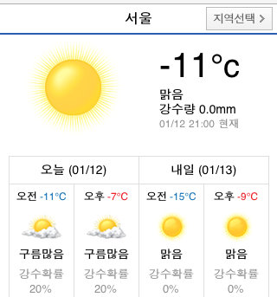
Day’s information
Additional fields
Biorhythm
Weather
Myfortune
Link
Notes:
Every day, Monkey calendar provides funny information.
We provide three day’s information.
Biorhythm, weather, and my fortune.
If user click weather,
User can see that day’s weather through link.
In other words, user must uses internet.
Biorhythm and Myfortune are also provided by link.

Slide 16
Additional Language
Additional fields (optional)
FEBRUARY
MARCH
Volunteer Work
Name
Volunteer Work
Name
Day
3 / 9 / 2011
Day
2 / 9 / 2011
Start
Pm. 2
Start
Pm. 2
Pm. 7
End
Pm. 7
End
Location
Korea univ.
Location
Korea univ.
People
Colleague
People
Colleague
Sometimes location will be changed.
Sometimes location will be changed.
Description
Memo
Notes:
Additional language의 경우 monkey calendar에 확실히 포함될지는 모르기 때문에 optional fields 입니다.
만약 user가 원한다면, 설정을 통해 language를 변환할 수 있습니다.
현재는 English와 Korean을 지원할 예정입니다.

Slide 17
Localization
Localization to current region(optional)
FEBRUARY
내용
3월
Volunteer Work
제목
Volunteer Work
Name
일
월
화
수
목
금
토
날짜
3 / 9 / 2011
Day
2 / 9 / 2011
시작시간
Pm. 2
Start
Pm. 2
Pm. 7
끝 시간
Pm. 7
End
장소
Korea univ.
Location
Korea univ.
사람
Colleague
People
Colleague
Sometimes location will be changed.
Sometimes location will be changed.
추가 설명
Memo

Slide 18
Environment
Android version : 2.1
Resolution : 800 x 480 WVGA
Input device : touch, virtual keyboard
Notes:
Our application will be developed on Android 2.1.
2.1 a.k.a. Éclair is most popular version of android.
And except one person we have Android 2.1 phones in our team.
To test our application we will test our own phones. But all of them has Éclair version.
And this resolution is widely used in these days.
Definitely the phones support touch screen. So User Interface will be based on touch screen input device.

Slide 19

Ask me anything!

